Slide 1
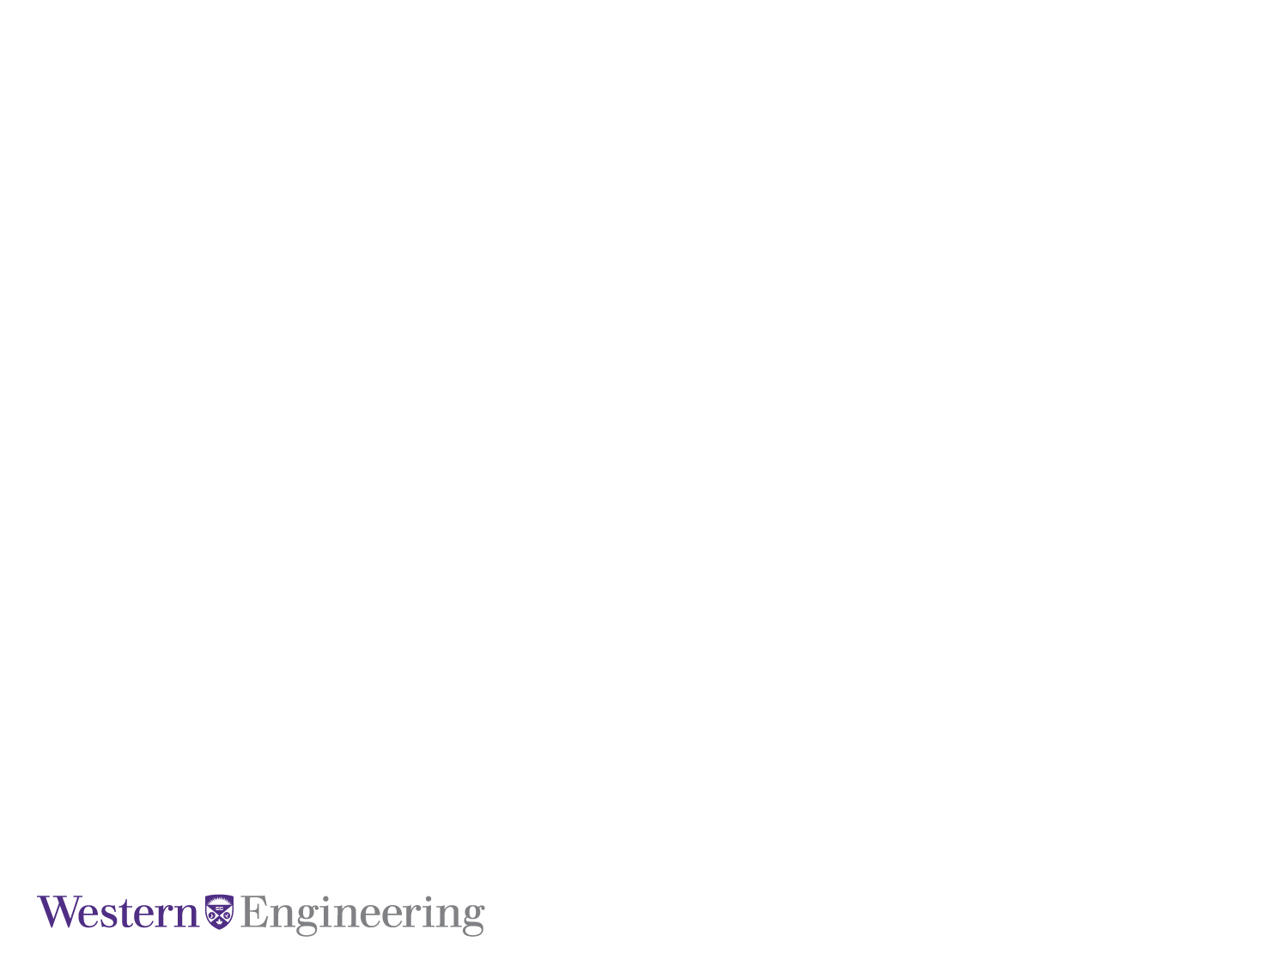
Modeling of Practical CT based on Lucas Model and Study of CT saturation
Khashayar Namdar
Seyedashkan Miraftabi
March 2023
Department of Electrical and Computer Engineering

Slide 2
Background
CT/PT are part of protection scheme of the power system
During faults/disturbance, CT saturation leads to maloperation of protection system*
Accidental operations may damage power equipment and also threaten the reliability of the system.
Importance of study of transient characteristics of CT
CT is modeled using Lucas model parameters, using simulated annealing algorithms.
*Y Wang, X Qi, H Luo,et.Complex sympahtetic inrush and its influence on current differential protection[J]. Automation of Electric Power systems..2014,(06): 98-105.

Slide 3
Modeling of CT
Critical point of CT simulation model is simulating the transient characteristics of CT.
Jiles-Atherton (J-A) model* is based on Differential equations.
Uses differential equations to simulate the relationship between flux density B and magnetic field strength H
Lucas model^ based on non-integer power series.
Most power system transient simulation software above two CT models.
*Jiles D C, Atherton D L. Theory of ferromagnetic hysteresis[J]. Journal Of Applied Physics, 1984, 55(6):2115-2120.
^Lucas, J.R.. "Representation of magnetization curves over a wide region using a non-integer power series", IJEEE, Vol 25, No. 4, 1988, Manchester U.P., UK, pp.335-340

Slide 4
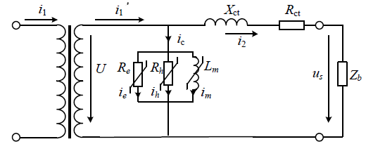







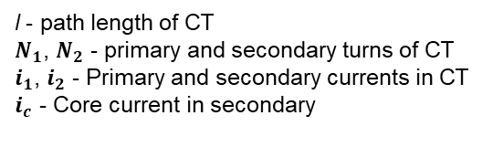


Analysis of Lucas model
Nonlinear power curve to describe the CT magnetizing characteristic is,
$$H=ΣK_{i}B^{n_{i}}$$
$K_{i}$ >0, $n_{i}>0 for all i$
$n_{1}$= 1
$$(1)$$
$$H=K_{1}B+K_{2}B^{n_{2}}+K_{3}B^{n_{3}}$$
$$(2)$$
$Hl=$ $N_{2}i_{c}$
$$(3)$$
l - path length of CT
$N_{1}$, $N_{2}$ - primary and secondary turns of CT
$i_{1}$, $i_{2}$ - Primary and secondary currents in CT
$i_{c}$ - Core current in secondary
$i_{c}= i_{m}$ + $i_{e}$ + $i_{h}$
$$(4)$$

Slide 5




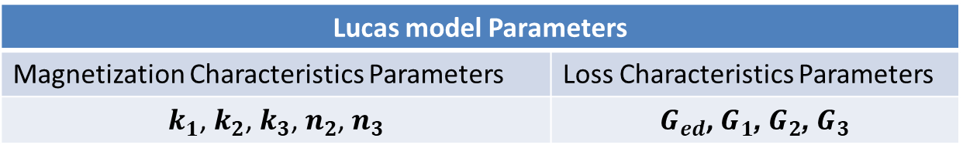
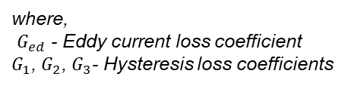


Analysis of Lucas model
Eddy loss Current and hysteresis loss current is given below
$$i_{e}=G_{ed}⋅U$$
$$(5)$$
$$i_{h}=G_{1}.sign\left(U\right).\sqrt{\left|U\right|}+{G_{2}.U.\left|B\right|}^{3}+{G_{3}.U.\left|B\right|}^{15}$$
$$(6)$$
where,
$G_{ed}$ - Eddy current loss coefficient
$G_{1}$, $G_{2}$, $G_{3}$- Hysteresis loss coefficients
Combining equations (2) & (3),
$$i_{c}=k_{1}B+k_{2}B^{n_{2}}+k_{3}B^{n_{3}}$$
where, $k_{i}$= $\frac{l. { K}_{i}}{{ N}_{2}}$
$$(7)$$
Lucas model Parameters
Magnetization Characteristics Parameters | Loss Characteristics Parameters
$k_{1}$, $k_{2}$, $k_{3}$, $n_{2}$, $n_{3}$ | $G_{ed}$, $G_{1}$, $G_{2}$, $G_{3}$

Slide 6
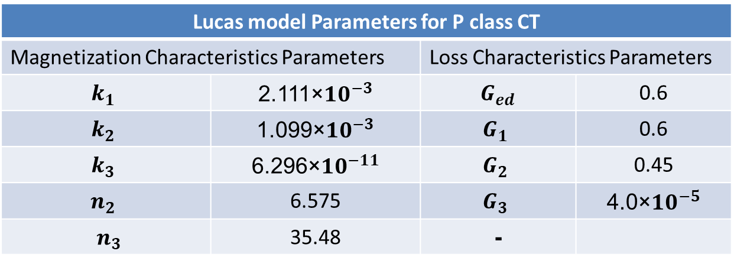
Lucas model parameters
Authors have conducted tests on practical 220kV P class CT to obtain Lucas model parameters*
Lucas model Parameters for P class CT
Magnetization Characteristics Parameters |  | Loss Characteristics Parameters
$$k_{1}$$ | 2.111×${10}^{−3}$ | $G_{ed}$ | 0.6
$$k_{2}$$ | 1.099×${10}^{−3}$ | $$G_{1}$$ | 0.6
$$k_{3}$$ | 6.296×${10}^{−11}$ | $$G_{2}$$ | 0.45
$$n_{2}$$ | 6.575 | $$G_{3}$$ | 4.0×${10}^{−5}$
$n_{3}$ | 35.48 | -
*In dynamic simulation laboratory of Huazhong University of Science and Technology, different practical protective CTs, include 220kV P class CT, 500kV PR class and 500kV TPY class CT are used to do physical tests

Slide 7
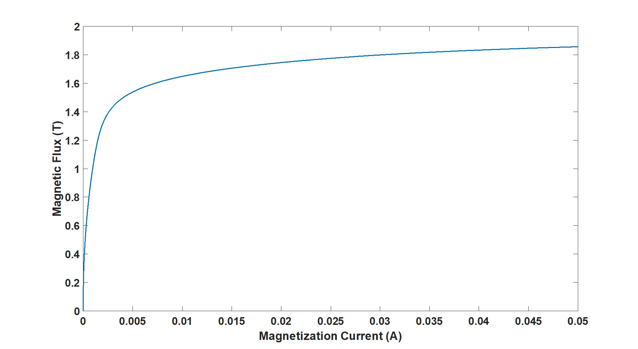
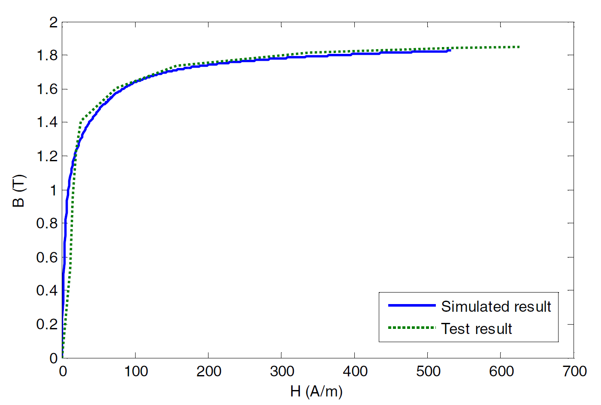
CT based on Lucas Parameters
Magnetizing curve of CT modeled in PSCAD is shown below
Simulated curve
Results from paper

Slide 8
Model Verification
Lucas parameters are derived for 2 more CT class
Simulated Hysteresis curve is compared with actual test results
Due to unavailability of the practical CT for comparing results, this part is omitted.
The modeled CT is tested for accuracy and response for transient characteristics by subjecting to few test cases.
System parameters of the test system are not available.
Alternative Model
Aim is to verify the model and test the CT saturation characteristics.
A similar test system is considered
CT saturation characteristics are studied

Slide 9

Simulation Results

Slide 10
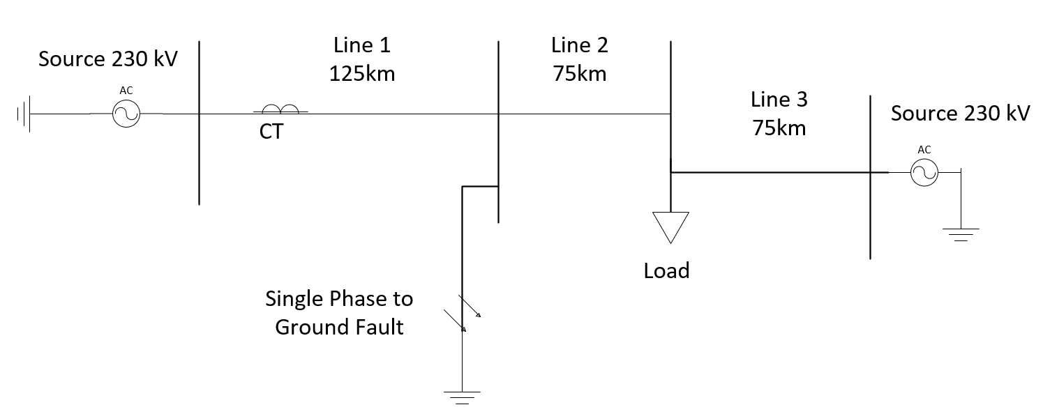
Test System for the Study
The ac system shown below consists of two 230 kV voltage sources, a 75 MVA load and three 230 kV transmission lines (125 km, 75 km and 75 km). A single phase (Phase A) to ground fault is applied between the first two transmission lines.
Min=0.375 (s)
Max=0.3876 (s)

Slide 11
Impact of DC offset in primary fault current
Case a: Fault is applied at a voltage minimum.

Slide 12
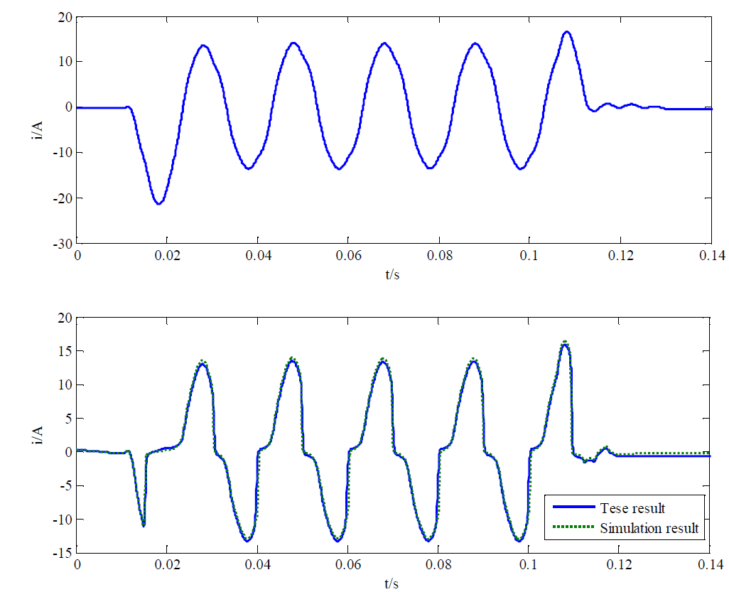
Impact of DC offset in primary fault current
Paper results for a specific simulation

Slide 13
Impact of DC offset in primary fault current
The DC offset causes the CT flux to into saturation.
Saturation occurs within one cycle.
Causes the secondary current to reduce.
After the fault is cleared, CT core still has some remnant flux.

Slide 14
Impact of DC offset in primary fault current
Case b: Fault is applied at a voltage Maximum.

Slide 15
Impact of DC offset in primary fault current
No DC offset.
CT core does not saturate
Secondary current of CT is a faithful scaled down version of the primary.

Slide 16
Impact of Remanence
Effect of remnant flux on saturation

Slide 17
Effect of CT Burden on saturation
With less CT burden, flux traverses less and the CT takes longer for saturating

Slide 18
Effect of CT Burden on saturation

Slide 19
Study Extensions
Study of CT Saturation can be extended to analysis of Relay operation during transients.
A test system with Distance relay can be used and the effect of transients on the relay operation
Lucas model CT can replaced by J-A model CT. Results can compared.

Slide 20
Conclusion
Need for modeling of CT for efficient and proper operation of the protection system.
Understanding of Lucas Model.
CT modeling with Lucas model parameters in PSCAD.
Study of modeled CT during transients.
Effect of Remanence & Burden on saturation.

Slide 21
References
Qian Guo, Xianggen Yin,et al. “Modeling of Practical Protective CT Based on Lucas Model” 2017 IEEE Transportation Electrification Conference and Expo, Asia-Pacific (ITEC Asia-Pacific)
D Chen, X Yin, Z Zhang,et “Test study on the transient performance of the electro-magnetic type current transformer[J]”. Power System Protection and Control.2008,(13): 1-4.
Lucas J R, McLaren P G, Keerthipala W W L,et al. “Improved simulation models for current and voltage transformers in relay studies[J]” Power Delivery, IEEE Transactions on, 1992, 7(1):152-159
Jiles D C, Atherton D L. “Theory of ferromagnetic hysteresis[J]”. Journal Of Applied Physics, 1984, 55(6):2115-2120.

